Slide 1
Decomposition Tree
Decomposition Tree

Slide 2
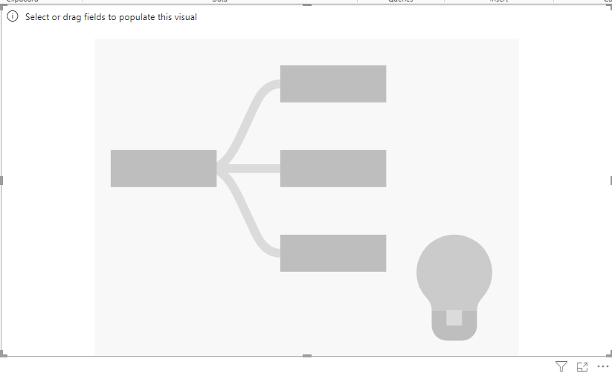
Decomposition tree
Note: This lab is based on the excel file Sales.xlsx in Excel Sources
Add a Decomposition Tree to the scene

Slide 3
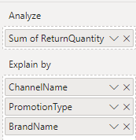

Decomposition tree
Add Return Quantity from FactSales table to the Analyse and Channel Name, Promotion Type and Brand Name
to Explain by and observe
Analysis suggestions
The total of Return Quantity

Slide 4
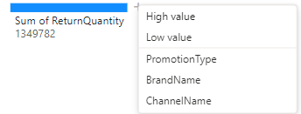
Decomposition tree
Click on + sign
If clicked first then Power BI will suggest based on
AI what analysis axe comes first either Promotion Type
Or Brand Name or Channel Name and it gives
The highest values of Return Quantities based on that
Analysis axe
If clicked first then Power BI will suggest based on
AI what analysis axe comes first either Promotion Type
Or Brand Name or Channel Name and it gives
The lowest values of Return Quantities based on that
Analysis axe

Slide 5
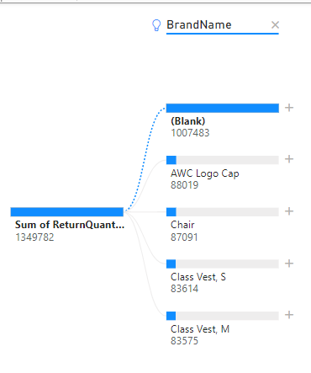
Decomposition tree
Click on + sign proposes the Brand Name that comes first
The light blub indicates that the analysis axis is chosen by
Power BI and not the user

Slide 6
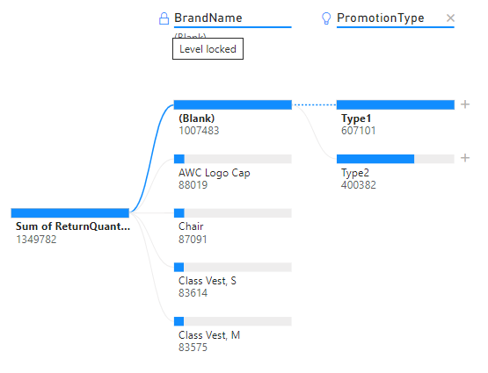
Decomposition tree
Double click on the analysis axis and a Lock sign will appear that means that axis is now fixed and couldn’t be replaced until it is unlocked the will disappear if

Slide 7
Thank you
Thank you

